Slide 1
**File Handling**

Slide 2
What is file?
File is named location on disk too store related information. It is used to store data permanently in a non-volatile memory (e.g. hard disk)
Since, random access memory (RAM) is volatile which loses its data when computer is turned off, we use files for future use of the data.
File Handling:
It is the traditional and common way to store small amount of data permanently.
It allows users to perform file operation(read/Write).
The concept of file handling has stretched over various other languages, but the implementation is either complicated or lengthy, but alike other concepts of Python, this concept is also easy and short.

Slide 3
Very small amount of information. e.g. we need to store mobile number or name of 100 students.
Files
If we need to store huge information. E.g. transaction info of particular Bank.
Database
If we need to store very huge data. E.g youtube videos, facebook posts, twitter posts.
Big Data

Slide 4
Why file handling is necessary?
As we know that data structures (list, tuple, set, dictionary) in python are temporary. They will destroy after the completion of program execution because they are allocated in RAM(volatile memory).
To store the data Permanently and we can use the data for the future use.

Slide 5
Types of files:
Text files – Text files are those files which store the character data. E.g. .txt files
Binary files – Binary files are those files which store data in binary form. E.g. images, videos, audio, zip files etc.
Remember:
Before performing any operation in a file, the first thing to do is open a file first.
After completion of operation in a file, we need to closed the file, so that resources tied with that files are freed.

Slide 6
Order of file operation takes place in following order:
1. open a file
2. Read and Write (Perform operation)
3. Close the file.
Read/Write
Operation
Open a file
Close a file

Slide 7
How to open a file?
Python has a built-in function open() to open a file.
This function returns a file object which is used to read or modify the file accordingly.
F=open( filename, mode)
Open function takes two arguments :
Filename – filename can be given in two ways: if file is in current directory just we can give file name(relative path) otherwise you should provide full path of a file (absolute path )
Mode - The allowed values for mode are: r, w, a, r+, w+, a+, x

Slide 8
Mode: for text files.
Read (r) : f=open(‘abc.txt’)
Open an existing file for read operation.
This is default mode for file operation.
If file is not found( not available ), FileNotFoundError
Write (w) : f=open(‘abc.txt’, ’w’)
Open an existing file for write operation.
If file is not available, it will create the file automatically.
If file is available and contain some data, it will overwrite.

Slide 9
Append (a) : f=open(‘abc.txt’, ‘a’)
Open an existing file to append the data.
If file is not available it will create new file automatically.
One difference between write and append, write mode overwrite the data whereas append mode append data.
Read and write (r+) : f=open(‘abc.txt’, ‘r+’)
This mode open file for read first and write mode.
So, it do not overwrite data.
File must be available to open otherwise, FileNotFoundError occurred.

Slide 10
Write and read (w+) : f=open(‘abc.txt’, ‘w+’)
This mode open an existing file to write first and read
So, it overwrite data
If file is not available, it will create file automatically.
Append and read (a+) : f=open(‘abc.txt’, ‘a+’)
This mode open an existing file to append data first and read.
Exclusive (x): f=open(‘abc.txt’, ‘x’)
This mode open new fresh file for write operation.
If file is already exist, FileExistError

Slide 11
Mode: for binary files
It is similar to text files mode but we have to add ‘b’ in each mode in binary files.
rb – read mode
wb – write mode
ab – append mode
r+b – read and write mode
w+b – write and read mode
a+b – append and read mode
xb – exclusive mode

Slide 12
Closing file :
Fileobjectname.close()
Ex: f.close()
Getting properties of file :
name – give the name of the file (f.name)
Mode – give the mode in which file is open (f.mode)
Closed – give the Boolean value (false) is file is closed (f.closed)

Slide 13
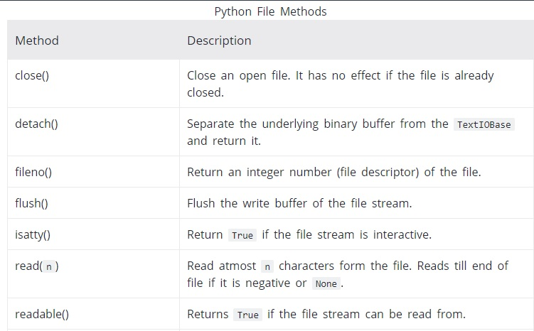
File Methods:

Slide 14
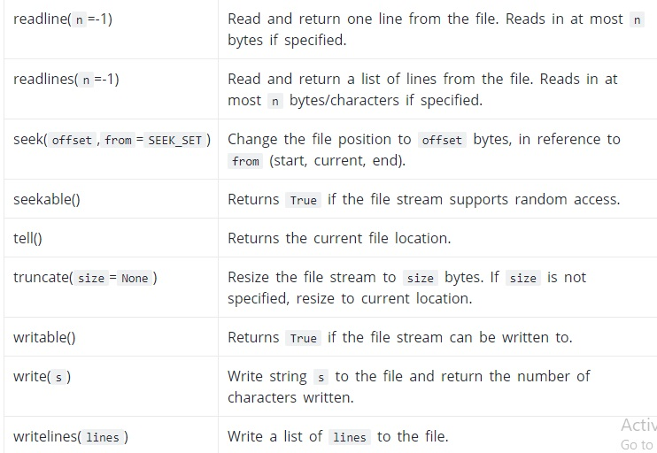
File methods:

Slide 15
Write method:
write(s) – write a single line
writelines(ls)- write list of string.
Read method:
read() – to read total data from the file.
read(n) – to read n character from the file.
readline() – to read single line from the file.
readlines() – to read list of lines from the file.

Slide 16
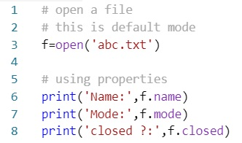

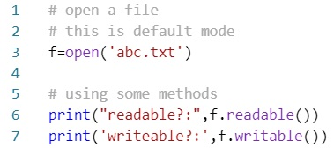

Code: file’s properties and methods.

Slide 17
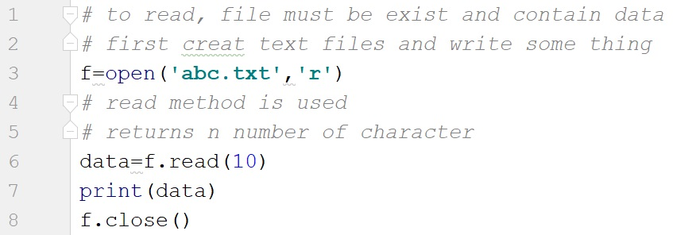
Code: reading from the file.
**Using read() method
** try with readline() and readlines() method

Slide 18
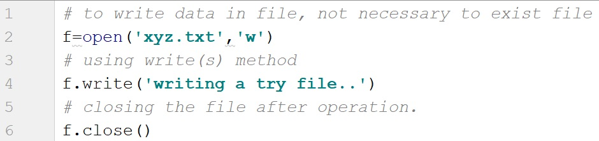
Code : writing data to the file
** writing data in a file using write() method.
** write a data in a file using writelines() method.

Slide 19
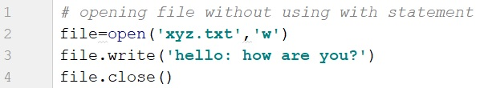

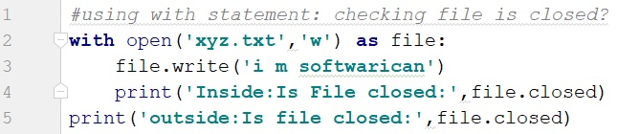

With statement:
With statement is used in order to close file automatically.

Slide 20
Pickling and Unpickling:
What is pickling?
“Pickling” is the process whereby a python object hierarchy is converted into a byte stream.
What is unpickling?
“unpickling” is the inverse operation, whereby a byte stream(from a binary file or bytes-like object) is converted back into an object hierarchy.

Slide 21
What is the use of pickling in python?
Pickle in python is primarily used in serializing and deserializing a Python object into a byte stream to store it in a file/database, maintain program state across sessions, or transport data over the network.
In other words, Pickling is useful when you want to save the state of your objects and reuse them at another time without losing any instance specific data.

Slide 22
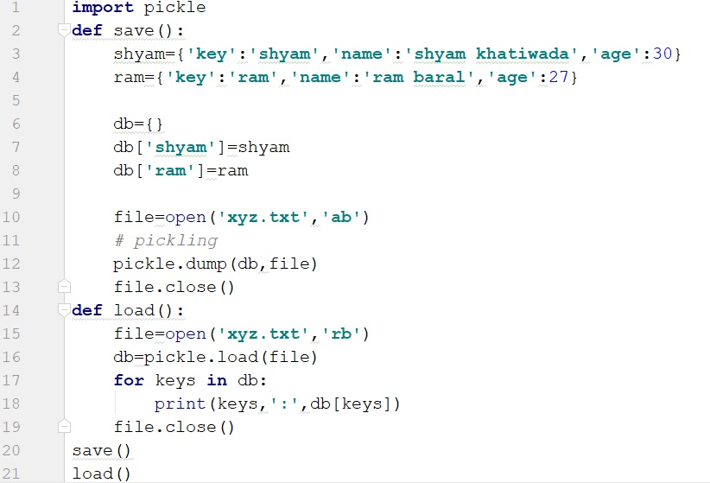
Code:
Pickling
Unpickling

Slide 23
** The- End**

